Slide 1
Java Programming
P2-Control Flow Statements

Slide 2
Control Flow Statements
The statements inside your source files are generally executed from top to bottom, in the order that they appear. Control flow statements, however, break up the flow of execution by employing decision making, looping, and branching, enabling your program to conditionally execute particular blocks of code.
Decision-making statements:
if-then, if-then-else, switch
Looping statements:
for, while, do-while
Branching statements:
break, continue, return

Slide 3
The if-then-else Statement
The if-then statement is the most basic of all the control flow statements. It tells your program to execute a certain section of code only if a particular test evaluates to true.
The if-then-else statement provides a secondary path of execution when an "if" clause evaluates to false
当if表达式结果为true时，执行then代码块；结果为false时，执行else代码块
If(表达式) {
then代码块
} else {
else代码块
}

Slide 4
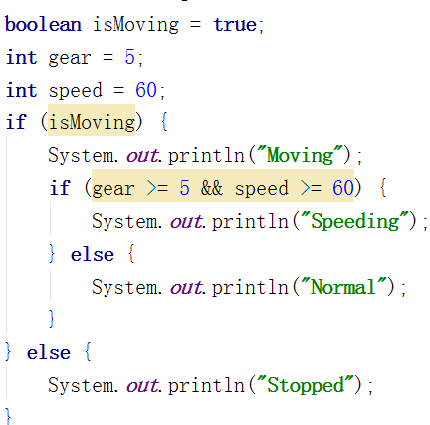
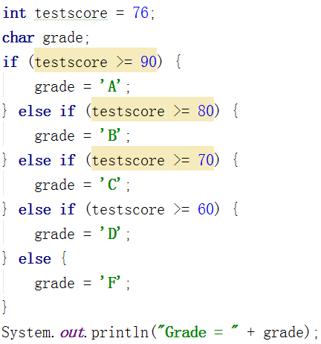
CC：if语句代码块必须显式使用大括号。使用大括号声明代码块可以使代码结构清晰

Slide 5
The switch Statement
The switch statement can have a number of possible execution paths. A switch works with the byte, short, char, and int primitive data types. It also works with enumerated types, the String class.
A statement in the switch block can be labeled with one or more case or default labels. The switch statement evaluates its expression, then executes all statements that follow the matching case label.

Slide 6
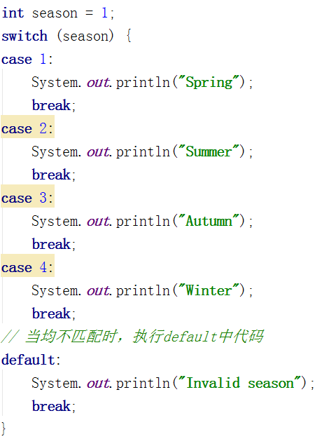

Slide 7
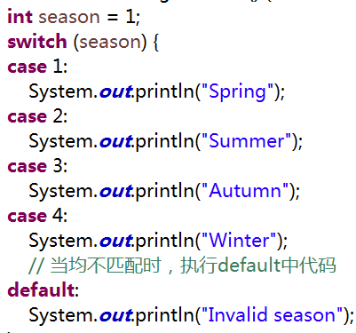
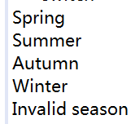
All statements after the matching case label are executed in sequence, regardless of the expression of subsequent case labels, until a break statement is encountered.
Switch支持整数/枚举/字符串作为表达式；当匹配case中表达式时，执行相应代码块；并顺次执行之后的全部分支直到break语句。
从匹配的case执行
如果case没有break
则继续执行下一个case
直到break或switch结束

Slide 8
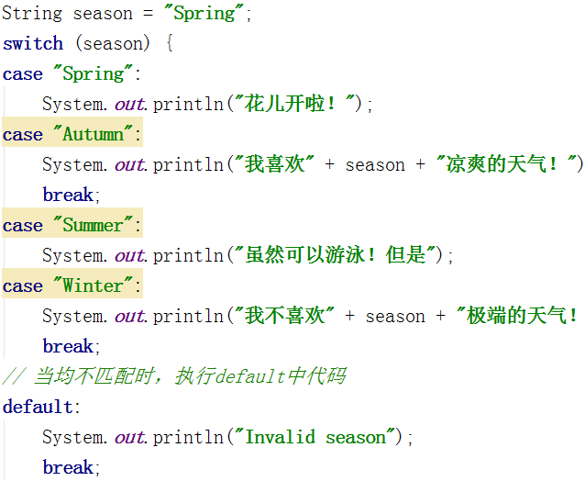


You can use a String object in the switch statement's expression.
当执行本case时
需要同时执行下一个case
因此，无需break
session = Autumn
基于具体需求决定
是否需要default
Case是否需要break

Slide 9
基于可读性和预执行的表达式，选择恰当的决策语句
If，支持基于值/条件范围/运算符等的复杂表达式，但表达式结果仅支持boolean类型
Switch，支持整数/枚举/字符串等多种类型，但分支固定
当表达式使用switch不支持的类型时

Slide 10
The while and do-while Statements
The while statement continually executes a block of statements while a particular condition is true.
The while statement evaluates expression, which must return a boolean value. If the expression evaluates to true, the while statement executes the statement(s) in the while block. The while statement continues testing the expression and executing its block until the expression evaluates to false.
The difference between do-while and while is that do-while evaluates its expression at the bottom of the loop instead of the top. Therefore, the statements within the do block are always executed at least once
while(expression) {
statements
}

Slide 11
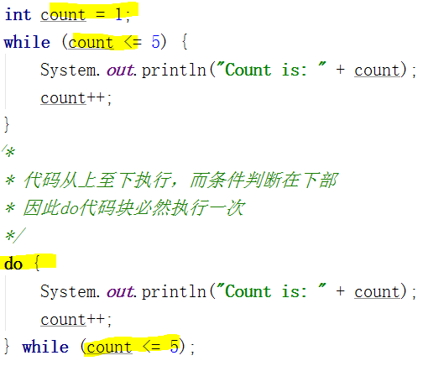
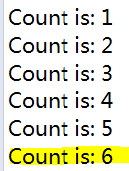

Slide 12
The for Statement
The for statement provides a compact way to iterate over a range of values. Programmers often refer to it as the "for loop" because of the way in which it repeatedly loops until a particular condition is satisfied.
initialization expression，循环开始时，执行初始化表达式一次
termination expression ，当终止表达式结果为false时，终止循环
increment expression，在循环的每次迭代之后调用，增加/减少一个值
for(initialization; termination; increment) {
statements
}

Slide 13

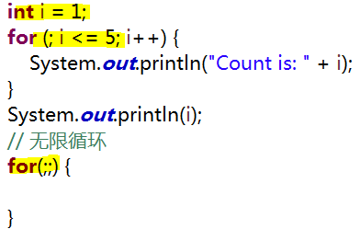
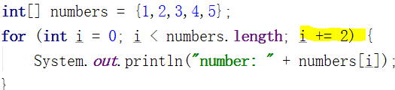
仅初始化时，执行一次
每次迭代时，执行
每次迭代后，执行
++++++++++++++++++++++++++++++++
可由由外部获取
++++++++++++++++++++++++++++++++
步进2

Slide 14
The for Statement
The for statement provides a compact way to iterate over a range of values. Programmers often refer to it as the "for loop" because of the way in which it repeatedly loops until a particular condition is satisfied.
initialization expression，循环开始时，执行初始化表达式一次
termination expression ，当终止表达式结果为false时，终止循环
increment expression，在循环的每次迭代之后调用，增加/减少一个值
for(initialization; termination; increment) {
statements
}

Slide 15
仅初始化时，执行一次
每次迭代时，执行
每次迭代后，执行
++++++++++++++++++++++++++++++++
可由由外部获取
++++++++++++++++++++++++++++++++
步进2

Slide 16
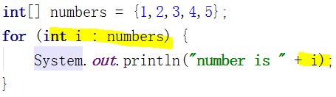
When you see the colon (:) read it as “in.” The loop above reads as “for each i in numbers.” As you can see, the for-each construct combines beautifully with generics. It preserves all of the type safety.

Slide 17
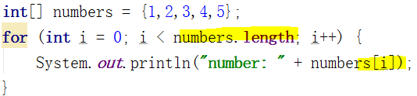
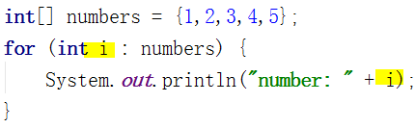
for语句支持另一种用于集合/数组的迭代形式，增强型for语句(forEach)，可用于使循环更紧凑且易于阅读
i为数组中元素的index索引
基于索引获取数组中的元素
指定数组/集合中
元素的类型
指定需遍历的数组/集合
i每次迭代的
数组/集合中的元素

Slide 18
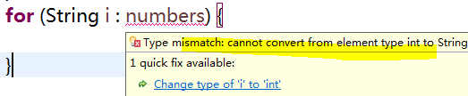
遍历数组/集合的适用场景
For，适合需要指定遍历次数，需要基于索引/次数完成进一步操作时
Foreach，适合遍历全部元素，无需基于元素索引位置操作时
We recommend using for-each form of the for statement instead of the general form whenever possible.
编译器完成
类型安全检测
当元素实际类型与声明不匹配时
无法编译

Slide 19
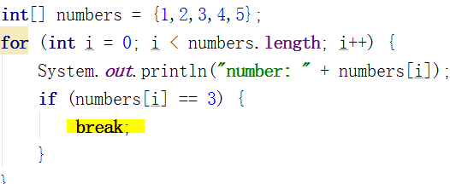

Branching Statements
You can also use an break statement to terminate a for, while, or do-while loop.
终止对应的循环
结束循环

Slide 20
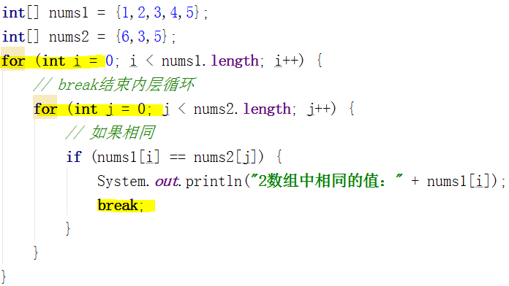

当相等时，仅终止内层循环

Slide 21
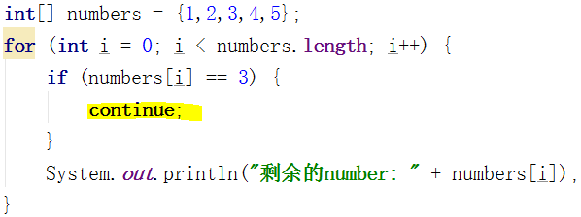
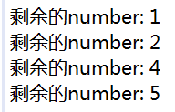
The continue statement skips the current iteration of a for, while , or do-while loop.
结束本次循环，开始下一循环
当执行continue是
终止本次循环的执行
继续下一循环

Slide 22
The return statement exits from the current method, and control flow returns to where the method was invoked. The return statement has two forms: one that returns a value, and one that doesn't. To return a value, simply put the value (or an expression that calculates the value) after the return keyword.
Return终止退出当前方法，将控制流程返回到调用该方法处

Slide 23
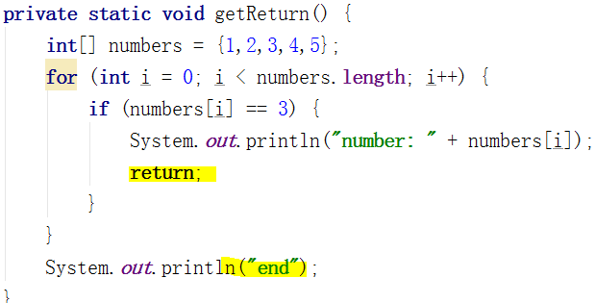



结束退出当前方法
？
在方法名称前
声明返回类型

Slide 24
Part2 - Summary
 | content
变量 | 变量的声明，命名规范
基本数据类型 | 8 + 1基本数据类型，默认值，范围，大小等
整数类型 | 基本整数类型，long类型后缀
转义符 | 特殊含义字符输出的处理
常量 | 常量的声明，命名规范
数组 | 数组的类型，，创建方法，索引，长度，引用传递
字面量 | 基本类型的字面量，值传递与引用传递
变量的作用范围 | 域，实例变量，类变量，类常量，局部变量，参数，默认值
算术运算符 | 取模，字符串拼接
等式与关系运算符 | 基本类型使用 == 判断值是否相等
条件运算符 | 布尔表达式执行条件，短路特性
运算符优先级 | 建议使用()括号强调有限顺序

Slide 25
 | content
基本数据类型转换 | 大范围到小范围的强制转换
注释 | 单行，多行，文档
If then else | 表达式值与执行的代码块
switch | 支持的类型，支持字符串，固定项，break，适应场景
While | 表达式
For | 声明方法，循环的过程
foreach | 适应场景，优缺点
Break | 终止的范围
Return | 方法的退出，有/无返回值的声明

